Slide 1
Parallel and Distributed GBT

Slide 2
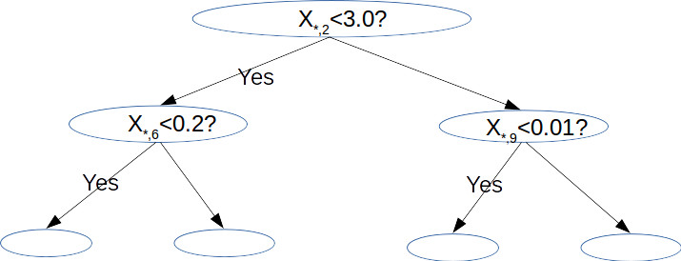
Assumption
Training Data N samples, M Features, build tree with L levels
Model GHSum with bin size B
at each node, size: B*M
at each level,size: 2^{L-1}B*M
Higgs, for example:
N = 10m, M = 28, L = 6, B = 256
model size at L=6, 32*256*28<<10m
Most cases
dense: M <1K, L<8
sparse can be an issue
deep tree can be an issue

Slide 3
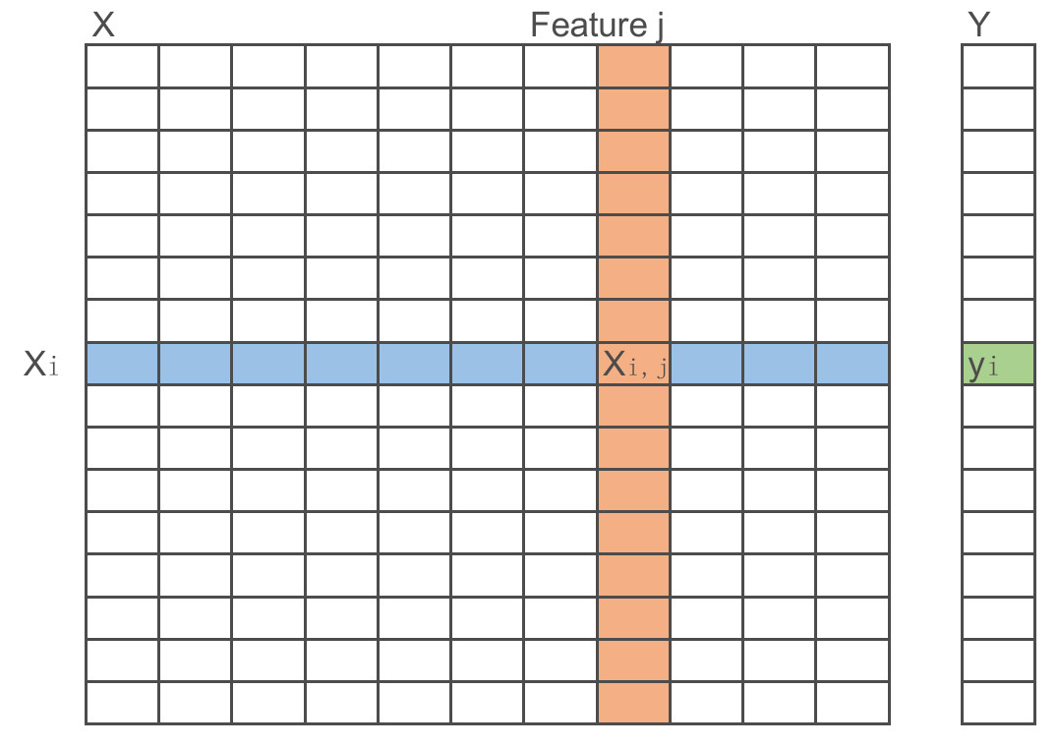
Cache Friendly Data Orgnization
Column-wised orgnization
Issue: non-continuous memory access
sorted by feature values
dynamic instance set
Proposal
multi-columns as a block to fit one cache line

Slide 4
Data Partition
In case N >> ModelSize
data parallelism: training data statically partitioned among nodes
model parallelism: optional and preferred when modelsize is big
Single pass on train data for each level. (half when reuse GHSum_{_parent})
Keep GHSum of the same level in memory

Slide 5
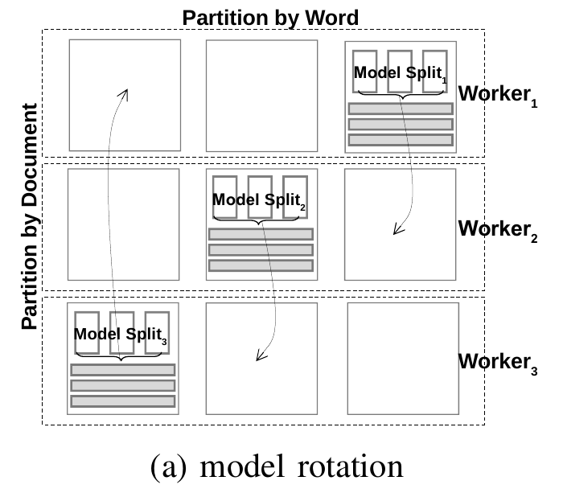
Data and Model Parallelism by Model Rotation
training data statically partitioned among nodes
GHSum split by feature columns
Scheduler to avoid update conflicts
rotate local model partition to neighbor at each sub-step
finish after K sub-steps(K nodes)
kind of a ring-allreduce

Slide 6
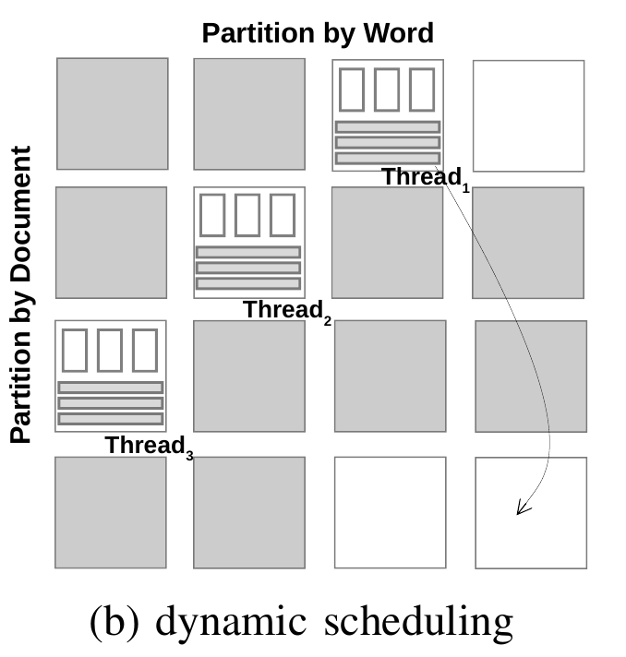
Block Dynamic Scheduling in Shared Memory systems
a low cost solution to remove synchronization overhead
number of partitions is larger than the number of threads,
always ‘free’ rows and columns avaliable when one thread finishes its current task.

Slide 7
Pipelining and Timer Control in Distributed Systems
Each sampler only works for the same period of time and then the samplers do synchronization all together.
They all use a timer to control the synchronization point rather than waiting until all the blocks to finish.
This adjustment does not change the property of the uniform random selection of blocks.

